Slide 1
Chapter 12
How to work with numbers, strings, and dates

Slide 2
Objectives (part 1)
Applied
Use the properties and methods of Number, String, and Date objects in your applications.
Use the random() method of the Math object to generate a random integer within a specific range.
Knowledge
Describe these special numerical values: Infinity, -Infinity, NaN, Number.MAX_VALUE, Number.MIN_VALUE, Number.MAX_SAFE_INTEGER, Number.MIN_SAFE_INTEGER, and Number.EPSILON.
Describe these methods of a Number object: toFixed() and toString().
Describe these static methods of the Number type: isNaN(), isFinite(), isInteger(), and isSafeInteger().

Slide 3
Objectives (part 2)
Describe these properties and methods of the Math object: PI, abs(), round(), ceil(), floor(), trunc(), pow(), sqrt(), min(), max(), and random().
Describe these properties and methods of a String object: length, charAt(), concat(), indexOf(), substr(), substring(), toLowerCase(), toUpperCase(), startsWith(), endsWith(), includes(), trimStart(), trimEnd(), trim(), padStart(), padEnd(), and repeat().
Describe how to use the split() method of a String object to create an array.
Describe how to create a Date object for the current date and time or for a specified date and time.

Slide 4
Objectives (part 3)
Describe these methods of the Date object: toString(), toDateString(), toTimeString(), getTime(), getFullYear(), getMonth(), getDate(), getDay(), getHours(), getMinutes(), getSeconds(), getMilliseconds(), setFullYear(), setMonth(), setDate(), setHours(), setMinutes(), setSeconds(), and setMilliseconds().
Describe the coding that’s required to add or subtract dates.
Describe how to use the Internationalization API to format numbers and dates.

Slide 5
Static properties of the Number object
Property Shortcut
Number.MAX_VALUE
Number.MIN_VALUE
Number.MAX_SAFE_INTEGER
Number.MIN_SAFE_INTEGER
Number.POSITIVE_INFINITY Infinity
Number.NEGATIVE_INFINITY -Infinity
Number.EPSILON
Number.NaN NaN

Slide 6
Examples of static properties of the Number object (part 1)
Example 1: Testing for Infinity, -Infinity, and NaN
if ( result == Infinity ) {
alert( "The result is greater than " + Number.MAX_VALUE );
} else if ( result == -Infinity ) {
alert( "The result is less than " + Number.MIN_VALUE );
} else if ( isNaN(result) ) {
alert( "The result is not a number" );
} else {
alert( "The result is " + result );
}
Example 2: Division by zero
alert( 0 / 0 ); // displays NaN
alert( 10 / 0 ); // displays Infinity
alert( -1 / 0 ); // displays -Infinity

Slide 7
Examples of static properties of the Number object (part 2)
Example 3: Safe and unsafe integers
const safe1 = Number.MAX_SAFE_INTEGER - 1;
const safe2 = Number.MAX_SAFE_INTEGER - 2;
const tooBig1 = Number.MAX_SAFE_INTEGER + 1;
const tooBig2 = Number.MAX_SAFE_INTEGER + 2;
alert( safe1 == safe2 ); // displays false
alert( tooBig1 == tooBig2 ); // displays true;
// ints not stored accurately

Slide 8
Instance methods of a Number object
toFixed(digits)
toString(base)

Slide 9
Examples of instance methods of the Number object
Example 1: Using the toFixed() method
const subtotal = 19.99, rate = 0.075;
const tax = subtotal * rate; // tax is 1.49925
alert( tax.toFixed(2) ); // displays 1.50
Example 2: Implicit use of the toString() method for base 10 conversions
const age = parseInt( prompt("Please enter your age.") );
alert( "Your age is " + age );

Slide 10
Static methods of a Number object
Number.isNaN(value)
Number.isFinite(value)
Number.isInteger(value)
Number.isSafeInteger(value)

Slide 11
Examples of static methods of a Number object (part 1)
Example 1: isNaN() vs Number.isNaN()
alert( isNaN("four") ); // displays true
alert( isNaN([1,2,3]) ); // displays true
alert( isNaN(NaN) ); // displays true
alert( Number.isNaN("four") ); // displays false
alert( Number.isNaN([1,2,3]) ); // displays false
alert( Number.isNaN(NaN) ); // displays true
Example 2: Using the isFinite() method
alert( Number.isFinite( 10 / 0 ) ); // displays false
alert( Number.isFinite( -1 / 0 ) ); // displays false
alert( Number.isFinite(200) ); // displays true

Slide 12
Examples of static methods of a Number object (part 2)
Example 3: Using the isInteger() and isSafeInteger() methods
const tooBig = Number.MAX_SAFE_INTEGER + 1;
alert( Number.isInteger(tooBig) ); // displays true
alert( Number.isSafeInteger(tooBig) ); // displays false
alert( Number.isSafeInteger(tooBig - 1) );
// displays true

Slide 13
One static property of the Math object
Math.PI
Example of the PI property
const area = Math.PI * 3 * 3;
// area is 28.274333882308138

Slide 14
Common static methods of the Math object
Math.abs(x)
Math.round(x)
Math.ceil(x)
Math.floor(x)
Math.trunc(x)
Math.pow(x, power)
Math.sqrt(x)
Math.min(x1, x2, ...)
Math.max(x1, x2, ...)

Slide 15
Examples of common methods of the Math object (part 1)
Example 1: The abs() method
const result_1a = Math.abs(-3.4); // result_1a is 3.4
Example 2: The round() method
const result_2a = Math.round(12.5); // result_2a is 13
const result_2b = Math.round(-3.4); // result_2b is -3
const result_2c = Math.round(-3.5); // result_2c is -3
const result_2d = Math.round(-3.51); // result_2d is -4
Example 3: The floor(), ceil(), and trunc() methods
const result_3a = Math.floor(12.5); // result_3a is 12
const result_3b = Math.ceil(12.5); // result_3b is 13
const result_3c = Math.trunc(12.5); // result_3c is 12
const result_3d = Math.floor(-3.4); // result_3d is -4
const result_3e = Math.ceil(-3.4); // result_3e is -3
const result_3f = Math.trunc(-3.4); // result_3f is -3

Slide 16
Examples of common methods of the Math object (part 2)
Example 4: The pow() and sqrt() methods
const result_4a = Math.pow(2,3); // result_4a is 8
const result_4b = Math.pow(125, 1/3); // result_4b is 5
const result_4c = Math.sqrt(16); // result_4c is 4
Example 5: The min() and max() methods
const result_5a = Math.max(12.5, -3.4);
// result_5a is 12.5
const result_5b = Math.min(12.5, -3.4);
// result_5b is -3.4

Slide 17
How to use the exponentiation operator instead of Math.pow()
const result_7a = 2 ** 3; // same as Math.pow(2,3)

Slide 18
The random() method of the Math object
Math.random()
How to generate a random number
const result = Math.random();

Slide 19
A function that generates a random number
const getRandomNumber = max => {
let random = null;
if (!isNaN(max)) {
// value >= 0.0 and < 1.0
random = Math.random();
// value is an integer between 0 and max - 1
random = Math.floor(random * max);
// value is an integer between 1 and max
random = random + 1;
}
// if max is not a number, will return null
return random;
};
A statement that calls the getRandomNumber() function
// returns an integer that ranges from 1 through 100
const randomNumber = getRandomNumber(100);

Slide 20
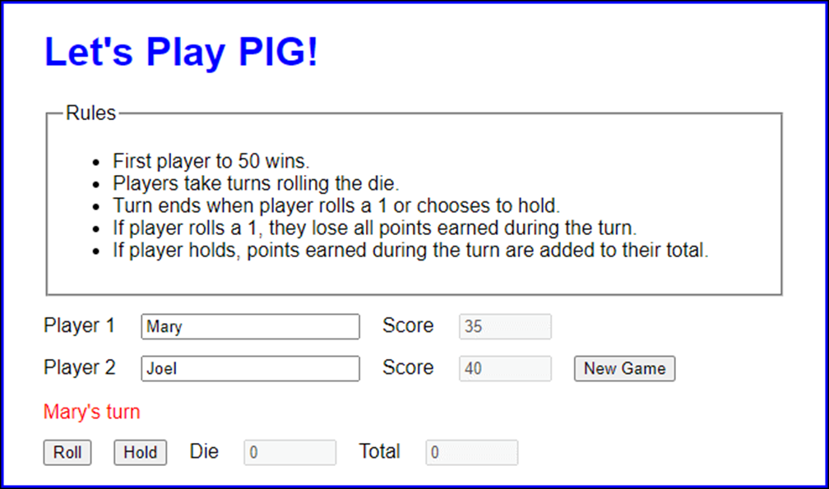
The user interface for the PIG application

Slide 21
The CSS for the PIG application
label {
display: inline-block;
margin-right: 1em;
}
input {
margin-top: 1em;
margin-right: 1em;
}
#turn div {
color: red;
margin-top: 1em;
}
#score1, #score2, #die, #total {
width: 5em;
}
.hide {
display: none;
}

Slide 22
The HTML for the PIG application (part 1)
<body>
<main>
<h1>Let's Play PIG!</h1>
<fieldset>
<legend>Rules</legend>
<ul>
<li>First player to <span id="winning_total">
</span> wins.</li>
...
</ul>
</fieldset>
<label for="player1">Player 1</label>
<input type="text" id="player1" >
<label for="score1">Score</label>
<input type="text" id="score1" value="0" disabled><br>
<label for="player2">Player 2</label>
<input type="text" id="player2">
<label for="score2">Score</label>
<input type="text" id="score2" value="0" disabled>
<input type="button" id="new_game" value="New Game"><br>

Slide 23
The HTML for the PIG application (part 2)
<section id="turn" class="hide">
<div><span id="current"></span>'s turn</div>
<input type="button" id="roll" value="Roll">
<input type="button" id="hold" value="Hold">
<label for="die">Die</label>
<input type="text" id="die" disabled>
<label for="total">Total</label>
<input type="text" id="total" disabled>
</section>
</main>
<script
src="https://code.jquery.com/jquery-3.4.1.slim.min.js">
</script>
<script src="pig.js"></script>
</body>

Slide 24
The JavaScript for the PIG application (part 1)
"use strict";
const winningTotal = 50;
const getRandomNumber = max => {
let rand = null;
if (!isNaN(max)) {
rand = Math.random();
rand = Math.floor(rand * max);
rand = rand + 1;
}
return rand;
};
const changePlayer = () => {
if ( $("#current").text() == $("#player1").val() ) {
$("#current").text( $("#player2").val() );
} else {
$("#current").text( $("#player1").val() );
}
$("#die").val("0");
$("#total").val("0");
$("#roll").focus();
};

Slide 25
The JavaScript for the PIG application (part 2)
$( document ).ready( () => {
$("#new_game").click( () => {
$("#score1").val("0");
$("#score2").val("0");
if ( $("#player1").val() == "" ||
$("#player2").val() == "" ) {
alert("Please enter two player names.");
} else {
$("#turn").removeClass("hide");
changePlayer();
}
});
$("#roll").click( () => {
let total = parseInt( $("#total").val() );
const die = getRandomNumber(6);
if (die == 1) {
total = 0;
changePlayer();
} else {
total = total + die;
}

Slide 26
The JavaScript for the PIG application (part 3)
$("#die").val(die);
$("#total").val(total);
});
$("#hold").click( () => {
let score = 0;
const total = parseInt( $("#total").val() );
if ( $("#current").text() == $("#player1").val() ) {
score = $("#score1");
} else {
score = $("#score2");
}
score.val( parseInt( score.val() ) + total );
if (score.val() >= winningTotal) {
alert( $("#current").text() + " WINS!" );
} else {
changePlayer();
}
});
$("#winning_total").text(winningTotal);
$("#player1").focus();
});

Slide 27
One property of a String object
length
Example of the length property
const message = "JavaScript";
const result_1 = message.length; // result_1 is 10

Slide 28
Methods of a String object
charAt(position)
concat(string1,string2, ...)
indexOf(search[,start])
substr(start,length)
substring(start)
substring(start,end)
toLowerCase()
toUpperCase()

Slide 29
Examples of methods of String objects (part 1)
Constant used by the following examples
const message = "JavaScript";
Example 1: The charAt() method
const letter = message.charAt(4); // letter is "S"
Example 2: The concat() method
const result_3 = message.concat(" rules");
// result_3 is "JavaScript rules"
Example 3: The indexOf() method
const result_4a = message.indexOf("a"); // result_4a is 1
const result_4b = message.indexOf("a", 2); // result_4b is 3
const result_4c = message.indexOf("s"); // result_4c is -1

Slide 30
Examples of methods of String objects (part 2)
Example 4: The substr() and substring() methods
const result_5a = message.substr(4, 5); // result_5a is "Scrip"
const result_5b = message.substring(4); // result_5b is "Script"
const result_5c = message.substring(0, 4); // result_5c is "Java"
Example 5: The toLowerCase() and toUpperCase() methods
const result_6a = message.toLowerCase(); // result_6a is "javascript"
const result_6b = message.toUpperCase(); // result_6b is "JAVASCRIPT"
// compare two strings ignoring case
alert( result_6a.toLowerCase() ==
result_6b.toLowerCase() ) // displays true

Slide 31
More methods of a String object
startsWith(string[,start])
endsWith(string[,length])
includes(string[,start])
trimStart()
trimEnd()
trim()
padStart(length[,string])
padEnd(length[,string])
repeat(times)

Slide 32
More examples of methods of String objects (part 1)
Constants used by the following examples
const str = "jQuery";
const len = str.length;
Example 1: The startsWith(), endsWith(), and includes() methods
const result_1a = str.startsWith("j"); // result_1a is true
const result_1b = str.startsWith("j", 2); // result_1b is false
const result_1c = str.endsWith("ry"); // result_1c is true
const result_1d = str.endsWith("ry", 2); // result_1d is false
const result_1e = str.includes("Que"); // result_1e is true
const result_1f = str.includes("Que", 2); // result_1f is false

Slide 33
More examples of methods of String objects (part 2)
Example 2: The padStart() and padEnd() methods
const result_2a = str.padStart(len + 3);
// result_2a is " jQuery"
const result_2b = str.padEnd(len + 3, "."); // result_2b is "jQuery..."
Example 3: The trimStart(), trimEnd(), and trim() methods
const str_2 = str.padStart(len + 3).padEnd(len + 6); // str_2 is " jQuery "
const result_3a = str_2.trimStart(); // result_3a is "jQuery "
const result_3b = str_2.trimEnd(); // result_3b is " jQuery"
const result_3c = str_2.trim(); // result_3c is "jQuery"
Example 4: The repeat() method
const result_4a = "Hey ".repeat(3); // result_4a is "Hey Hey Hey "

Slide 34
A String method that creates an array
split(separator[, limit])

Slide 35
Two constants that are used by the following examples
const fullName = "Grace M Hopper";
const date = "7-4-2021";
How to split a string that’s separated by spaces into an array
const words = fullName.split(" "); // words is ["Grace", "M", "Hopper"]
const len = words.length; // len is 3
const lastName = words[len - 1]; // lastName is "Hopper"
How to split a string that’s separated by hyphens into an array
const dateParts = date.split("-"); // dateParts is ["7", "4", "2021"]
const month = dateParts[0]; // month is "7"
const year = dateParts[2]; // year is "2021"

Slide 36
How to split a string into an array of characters
const characters = fullName.split("");
How to get just one element from a string
const firstName = fullName.split(" ", 1);
// firstName is ["Grace"]
const len = firstName.length; // len is 1
A statement that uses the firstName constant like a regular string
const greeting = `Hello, ${firstName}!`; // greeting is "Hello, Grace!"

Slide 37
How it works if the string doesn’t contain the separator
const dateParts = date.split("/");
// dateParts is ["7-4-2021"]
len = dateParts.length; // len is 1
How it works if the string contains the separator at the beginning or end
const path = "/directory/";
const pathParts = path.split("/");
// pathParts is ["", "directory", ""]

Slide 38
Summary of how the Date constructor works
Parameters Description
None Creates a new Date object set to the current date and time.
String value Creates a new Date object set to the date and time of the string.
Numeric values Creates a new Date object set to the year, month, day, hours, minutes, seconds, and milliseconds of the numbers. Year and month are required.
Date object Creates a new Date object that’s a copy of the Date object it received.
Invalid values Creates a new Date object that contains “Invalid Date”.

Slide 39
How to create a Date object that represents the current date and time
const now = new Date();
How to create a Date object by specifying a date string
const electionDay = new Date("11/3/2020");
const grandOpening = new Date("2/16/2021 8:00");
const departureTime = new Date("4/6/2021 18:30:00");

Slide 40
How to create a Date object by specifying numeric values
Syntax of the constructor for the Date object
new Date( year, month, day, hours, minutes, seconds,
milliseconds )
Examples
const electionDay = new Date(2020, 10, 3); // 10 is November
const grandOpening = new Date(2021, 1, 16, 8); // 1 is February
const departureTime = new Date(2021, 3, 6, 18, 30); // 3 is April

Slide 41
How to create a Date object by copying another Date object
const invoiceDate = new Date("8/8/2021");
const dueDate = new Date( invoiceDate );
// You can then add a number of days to due_date.

Slide 42
What happens when an invalid date is passed to the Date Constructor
const leapDate = new Date("2/29/2021"); // Invalid Date
Date strings that can lead to unexpected results in some browsers
const electionDay = new Date("11-3-2020"); // Invalid Date
const electionDay = new Date("11/3/20"); // 11/3/1920
How to check whether an object is a Date object
if (electionDay instanceof Date) { ... }

Slide 43
The formatting methods of a Date object
toString()
toDateString()
toTimeString()
Examples of the formatting methods
const birthday = new Date( 2001, 0, 7, 8, 25);
alert( birthday.toString() );
// "Sun Jan 07 2001 08:25:00 GMT-0800"
alert( birthday.toDateString() ); // "Sun Jan 07 2001"
alert( birthday.toTimeString() ); // "08:25:00 GMT-0800"

Slide 44
The get methods of a Date object
getTime()
getFullYear()
getMonth()
getDate()
getDay()
getHours()
getMinutes()
getSeconds()
getMilliseconds()

Slide 45
The set methods of a Date object
setFullYear(year)
setMonth(month)
setDate(day)
setHours(hour)
setMinutes(minute)
setSeconds(second)
setMilliseconds(ms)

Slide 46
How to display the date in your own format
const departTime = new Date(2021, 3, 16, 18, 30);
// April 16, 2021 6:30pm
const year = departTime.getFullYear();
// add 1 since months start at 0
const month = departTime.getMonth() + 1;
const day = departTime.getDate();
let dateText = year + "-";
// pad month if 1 digit
dateText += month.toString().padStart(2, "0") + "-";
// pad day if 1 digit
dateText += day.toString().padStart(2, "0");
// final dateText is "2021-04-16"

Slide 47
How to calculate the days until the New Year
const now = new Date(); // get current date and time
const newYear = new Date(now); // copy current date and time
newYear.setMonth(0); // set month to January
newYear.setDate(1); // set day to the 1st
newYear.setFullYear( newYear.getFullYear() + 1 );
// time in milliseconds
const timeLeft = newYear.getTime() - now.getTime();
// milliseconds in a day: hrs * mins * secs * milliseconds
const msInOneDay = 24 * 60 * 60 * 1000;
// convert milliseconds to days
const daysLeft = Math.ceil( timeLeft / msInOneDay );
let message = "There ";
if (daysLeft == 1) {
message += "is one day";
}
else {
message += "are " + daysLeft + " days";
}
message += " left until the New Year.";
// If today is November 3, 2020, message is
// "There are 59 days left until the New Year."

Slide 48
How to calculate a due date
const invoiceDate = new Date();
const dueDate = new Date( invoiceDate );
dueDate.setDate( dueDate.getDate() + 21 );
// due date is 3 weeks later

Slide 49
How to find the end of the month
const endOfMonth = new Date();
// Set the month to next month
endOfMonth.setMonth( endOfMonth.getMonth() + 1 );
// Set the date to one day before the start of the month
endOfMonth.setDate( 0 );

Slide 50
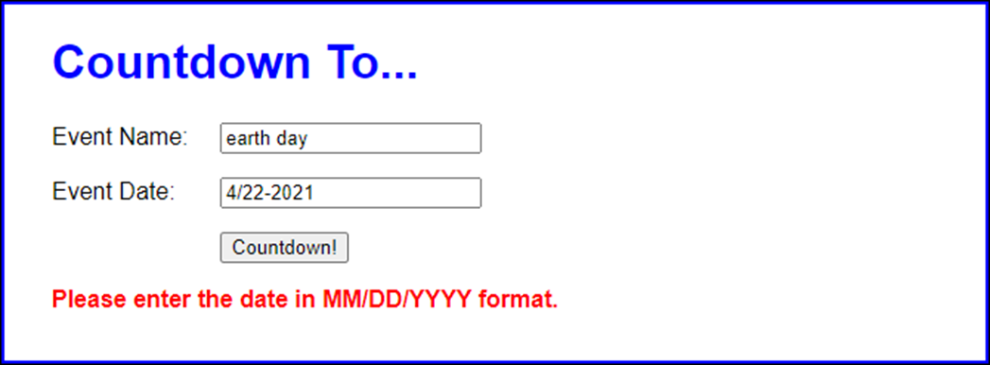
The user interface for the Count Down application

Slide 51
The HTML for the Count Down application (part 1)
<!DOCTYPE html>
<html lang="en">
<head>
<meta charset="UTF-8">
<meta name="viewport"
content="width=device-width, initial-scale=1">
<title>Count Down</title>
<link rel="stylesheet" href="count_down.css">
</head>
<body>
<main>
<h1>Countdown To...</h1>
<div>
<label for="event">Event Name:</label>
<input type="text" name="event" id="event">
</div>
<div>
<label for="date">Event Date:</label>
<input type="text" name="date" id="date"><br>
</div>

Slide 52
The HTML for the Count Down application (part 2)
<div>
<label>&nbsp;</label>
<input type="button" name="countdown"
id="countdown" value="Countdown!">
</div>
<div><label id="message"></label></div>
</main>
<script
src="https://code.jquery.com/jquery-3.4.1.slim.min.js">
</script>
<script src="count_down.js"></script>
</body>
</html>

Slide 53
The CSS style rule for the label element
#message {
color: red;
font-weight: bold;
}

Slide 54
The JavaScript for the Count Down app (part 1)
"use strict";
$( document ).ready( () => {
$("#countdown").click( () => {
const eventName = $("#event").val();
const eventDate = $("#date").val();
const messageLbl = $("#message");
// make sure user enters an event name and and date
if (eventName.length == 0 || eventDate.length == 0) {
messageLbl.text(
"Please enter both a name and a date." );
return;
}
// make sure event date string has two slashes
const dateParts = eventDate.split("/");
if (dateParts.length != 3) {
messageLbl.text(
"Please enter the date in MM/DD/YYYY format." );
return;
}

Slide 55
The JavaScript for the Count Down app (part 2)
// make sure event date string has a 4-digit year
const year = eventDate.substring(eventDate.length - 4);
if (isNaN(year)) {
messageLbl.text(
"Please enter the date in MM/DD/YYYY format." );
return;
}
// convert event date string to Date object
// and check for validity
let date = new Date(eventDate);
if (date == "Invalid Date") {
messageLbl.text(
"Please enter the date in MM/DD/YYYY format." );
return;
}

Slide 56
The JavaScript for the Count Down app (part 3)
// capitalize each word of event name
let formattedName = "";
const words = eventName.split(" ");
for (const i in words) {
const firstLetter =
words[i].substring(0,1).toUpperCase();
const word = firstLetter +
words[i].substring(1).toLowerCase();
formattedName += word.padEnd(word.length + 1);
}
formattedName = formattedName.trimEnd();
// calculate days
const today = new Date();
const msFromToday = date.getTime() - today.getTime();
const msForOneDay = 24 * 60 * 60 * 1000;
let daysToDate = Math.ceil( msFromToday / msForOneDay );

Slide 57
The JavaScript for the Count Down app (part 4)
// create and display message
let msg = "";
date = date.toDateString();
if (daysToDate == 0) {
msg = `Hooray! Today is ${formattedName}! (${date})`;
}
else if (daysToDate > 0) {
msg = `${daysToDate} day(s) until ${formattedName}!
(${date})`;
}
else if (daysToDate < 0) {
daysToDate = Math.abs(daysToDate);
msg = `${formattedName} happened ${daysToDate} day(s)
ago. (${date})`;
}
messageLbl.text(msg); });
});
$("#event").focus();
});

Slide 58
Two of the constructors of the Intl object
NumberFormat(locale[, options])
DateTimeFormat(locale[, options])
A method the the NumberFormat and DateTimeFormat objects
format(object)

Slide 59
How to use NumberFormat objects to format numbers
const us = new Intl.NumberFormat( "en-US" );
const de = new Intl.NumberFormat( "de-DE" );
const result_1a = us.format(1234567.89);
// result_1a is 1,234,567.89
const result_1b = de.format(1234567.89);
// result_1b is 1.234.567,89

Slide 60
How to use NumberFormat objects to format currency
const us = new Intl.NumberFormat(
"en-US", {style:"currency", currency:"USD"} );
const gb = new Intl.NumberFormat(
"en-GB", {style:"currency", currency:"GBP"} );
const de = new Intl.NumberFormat(
"de-DE", {style:"currency", currency:"EUR"} );
const result_2a = us.format(100200300.40);
// result_2a is $100,200,300.40
const result_2b = gb.format(100200300.40);
// result_2b is £100,200,300.40
const result_2c = de.format(100200300.40);
// result_2c is 100.200.300,40 €

Slide 61
How to use DateTimeFormat objects to format dates
const dt = new Date("7/4/2021");
const us = new Intl.DateTimeFormat( "en-US" );
const de = new Intl.DateTimeFormat( "de-DE" );
const result_3a = us.format(dt); // result_3a is 7/4/2021
const result_3b = de.format(dt); // result_3b is 4.7.2021

Slide 62
A URL with more information about the Internationalization API
https://developer.mozilla.org/en-US/docs/Web/JavaScript/ Reference/Global_Objects/Intl

